Slide 1
Customized Handmade Multimeter
Tailor-made for Analog Electronic Circuits lab requirements
Subject Code: BECE206L
Subject Name: Analog Circuits
Faculty: Dr Chandramauleshwar Roy
Lokesh R (23BEC1009)
Gautham R (23BEC1069)
Lalithkishore M (23BEC1088)
Siva Varshan A V (23BEC1262)

Slide 2
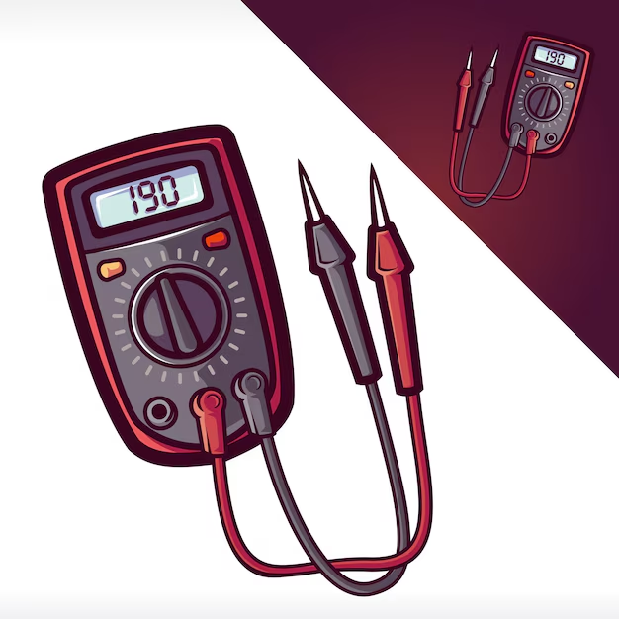
OBJECTIVE
To design and build a portable multimeter capable of measuring and displaying real-time readings on an LCD screen
Measurable parameters:
Voltage
Current
Resistance
Capacitance
Continuity
Frequency Measurement
Temperature measurement (Customized)

Slide 3
List of Components
NAME | SPECIFICATION | DESCRIPTION | QUANTITY | ESTIMATED COST (in Rs.)
Diodes | IN4148 or IN4007 | Rectification and protection circuits | 5 | 20
NPN Transistor | BC547 | Signal amplification and switching | 2 | 20
Operational Amplifier | LM358 | Amplification and signal conditioning | 2 | 40
Peak-to-peak detector | (Custom circuit) | AC Voltage Measurement | 1 | 500
Resistors | As per requirements | For current regulation | 10 | 20
Capacitors | As per requirements | Filtering and smoothing signals | 5 | 25
LED | Any colour | For indication | 5 | 10
Thermocouple Wire | Type K | Temperature sensing | 1 | 150
Cold-junction Compression IC | AD8495 | Compensates for temperature drift in thermocouples | 1 | 250
Voltage Reference IC | LM4040 | Provides a stable voltage reference | 1 | 100
Multimeter Setup | Box setup | To setup and connect separate units | 1 | 200

Slide 4
List of Components
NAME | SPECIFICATION | DESCRIPTION | QUANTITY | ESTIMATED COST (in Rs.)
Hall Effect Sensor | ACS712 (5A, 185mV/A sensitivity) | DC/AC Current Sensor | 1 | 300
Microcontroller | Arduino UNO | To read, process and display | 1 | 600
Display | 16x2 LCD Display | Acts as multimeter display | 1 | 250
Battery | 9V or AA pack | Power source for the multimeter | 1 | 60
Connecting Wires | General Connections | - | As needed | 30
Breadboard | - | Circuit Assembly | 1 | 100
Potentiometer | 10 kilo ohms | Calibration of measurements | 1 | 15
Switches/Buttons | AC/DC Switch | To toggle between modes | 1 | 200
Rotary Switch | 6 position, 16 pins | Mode Selector | 1 | 800
Thermocouple Connector | - | To connect thermocouples for temperature measurements | 1 | 50
Current Sensing Resistor | Shunt Resistor | For measuring current with precision | 1 | 10

Slide 5
Budget
₹3750
Estimated date of completion
October 14
(20 Days)

Slide 6
Voltage Measurement
Current Measurement
Frequency Measurement
Resistance Measurement
Concept: Voltage Division
DC Voltage: Measured directly through an analog pin.
AC Voltage: Detected using a peak-to-peak detector that converts AC voltage into a readable DC level.
Concept: Current Division
DC Voltage: Measured directly through an analog pin.
AC Voltage: Detected using a peak-to-peak detector that converts AC voltage into a readable DC level.
Concept: Pulse count per second
Frequency is determined by counting the number of signal pulses over a specific time interval.
Concept: Wheatstone Bridge
The bridge balances when the voltage across the two branches is zero, allowing you to calculate the unknown resistance based on known resistances.

Slide 7
Capacitance Measurement
Continuity Test
Temperature Reading (customized feature)
Concept: RC Charging Circuit
Measured by timing the charge and discharge cycles of a capacitor through a known resistor.
Concept: Flow of Current
Checks if the resistance between two points is low enough to allow current flow, indicated by a buzzer or LED.
Concept: Thermocouple
A thermocouple is made using two dissimilar metals (e.g., copper and constantan). The voltage difference between the metals generates a tiny voltage, which is amplified using an Operational Amplifier (op-amp) circuit. This is then sent to an analog temperature gauge calibrated to read temperature values.

Slide 8
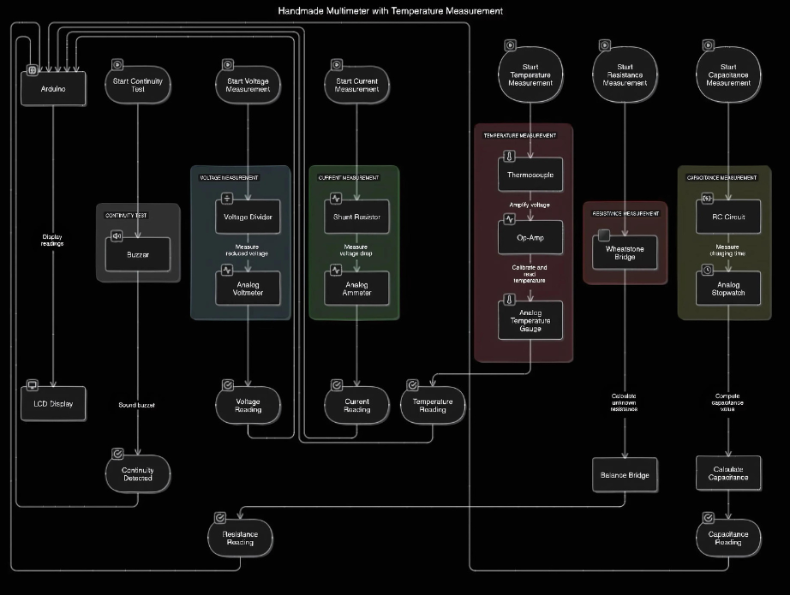

Slide 9
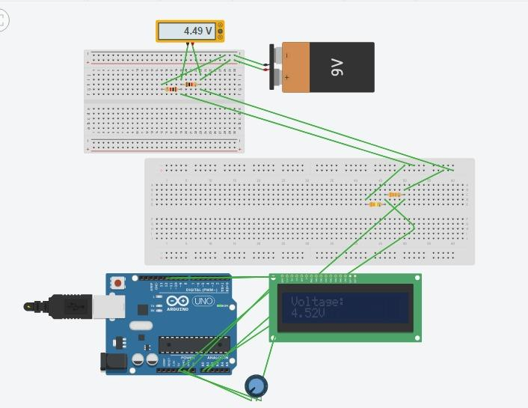
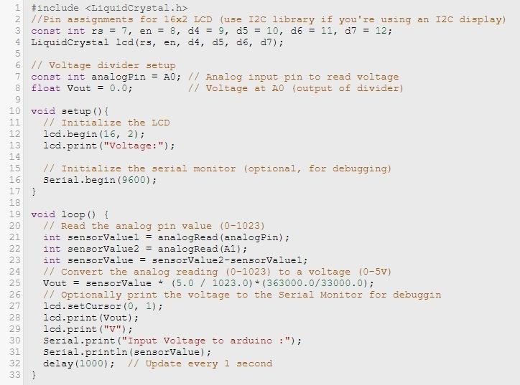

Slide 10
THANK YOU!
A presentation by
Lokesh R (23BEC1009)
Gautham R (23BEC1069)
Lalithkishore M (23BEC1088)
Siva Varshan A V (23BEC1262)
Slot: D1+TD1
Course Code: BECE206L

Slide 11

Template downloaded with thanks from

